Slide 1

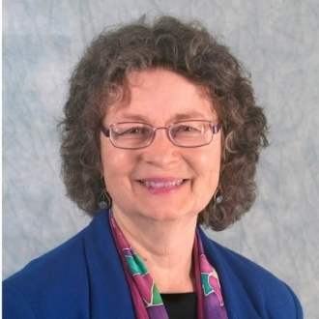


High Performing Nonprofits:
The importance of board and ceo evaluation
Connie Carter, CFRE
Sylvia/Carter & Associates
ccarter@sylviacarter.com
484.319.6454

Slide 2



Board Duties
Ensure Legal & Ethical Integrity
Build a Competent Board
Determine Mission & Purpose; Ensure Effective Planning; Monitor & Strengthen Programs & Services
Protect Assets & Provide Financial Oversight
Ensure Adequate Financial Resources
Enhance the Organization’s Public Standing
Select, Support & Evaluate the Chief Executive
BoardSource, https://boardsource.org/ Washington DC

Slide 3


Aims – Motivators - Barriers
Our goal today is to provide tips on how a CEO assessment & a Board self-assessment can be a positive, engaging & healthy process.
How can an annual CEO assessment help you and your nonprofit organization?
What are barriers to the Board engaging in an annual CEO assessment?
How can we make this a positive, engaging & healthy process?

Slide 4


Why Conduct An Annual Nonprofit CEO Assessment?
It’s the Board’s Job: Select, Support & Evaluate the CEO
Everyone Needs Feedback to Continue Growing
Discern Mission-related Progress, Outcomes & Needed Refinements. See trends over time
Legal CYA: Keep written records of evaluations from each year Protect the nonprofit: If there are discrepancies about compensation amounts or termination, written nonprofit CEO assessments can help set the record straight.
The IRS 990 says to (almost):
Checkbox on Compensation (which should be reviewed in relation to Performance Assessment)
Part VI, Section B, Line 15A: Governance & Management Policies: Did the process for determining compensation of the organization’s CEO, Executive Director or top management official include a review and approval by independent persons, comparability data, and contemporaneous substantiation of the deliberation and decision?

Slide 5


Basic Parameters – CEO Assessment
Assessment guides will give some helpful ideas
The CEO & Board should design the assessment process together
- collaborative effort
Evaluations should be tied to the strategic plan & the CEO job description
- annual strategic plan CEO goal setting & job description refinements are a natural outcome of a healthy CEO assessment process
The assessment feedback should be a conversation
There should be no big surprises. The CEO should be getting ongoing feedback, especially if there are issues emerging.

Slide 6

Best Practices – CEO Assessment
The more responsibility one holds, the more public the evaluation process becomes.
The CEO evaluation should involve at least the entire Board
Aim to make the review process objective, fair & valuable
Best Practice: Keep things fair, objective, open & SMART
Clear expectations and agreed-upon measurements are crucial
When goals are clear, it’s easier to discern results fairly and objectively
Set SMART goals: Specific, Measurable, Achievable, Realistic & Timely
Base the CEO evaluation on organizational strategic plan goals & core values
Best Practice: Evaluation is related to, but not exclusively tied to, nonprofit CEO Executive Compensation
Positive assessments are not always tied to increased compensation
Sometimes, the CEO works the hardest when budgets are down. This does not/cannot always mean a raise.
Process Should Include Feedback from
CEO: Self-evaluation: review goals set the previous year and reflect on progress made
Board: Observations of Board members
Assess in relation to strategic plan goals (rather than feelings about someone, one-time situations, etc.)
CEO & Board: Reflection reports on personal performance and growth plans
What areas surprised the CEO & the Board?
Where could the CEO have used more support?
What seems the most challenging of the growth plans, and how can the Board help the CEO succeed?

Slide 7

What to Include – CEO Assessment
Quantitative Evaluation Metrics
Program Service, Organizational Growth
Constituents served: maintain, increase, or decrease?
Program services: maintain, increase, or decrease?
New program development?
Fiscal Responsibility
Are financial trend lines moving in the right direction?
Did we contain expenses within budget?
Did we meet our budgeted income goals? (dollars raised & earned, donor retention, donor cultivation, etc.)
Qualitative Evaluation Metrics
Leadership
Does the CEO inspire staff, volunteers and board to do their best work?
What is turnover like under this CEO, and what do people say at their exit interviews?
Relationship-Building
Does the CEO foster beneficial relationships with specifically prioritized stakeholder groups?
Does the CEO consistently build trust with board members, staff members, and stakeholders?
Problem-Solving and Decision-Making
Does the CEO meet standards of professionalism, internally to staff/board and externally to public?
Does the CEO demonstrate an ability to develop and engage others in implementing action plans?

Slide 8
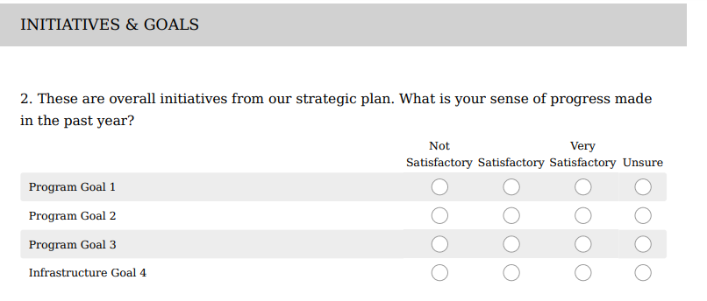
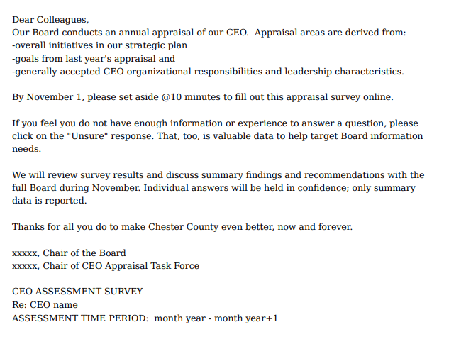
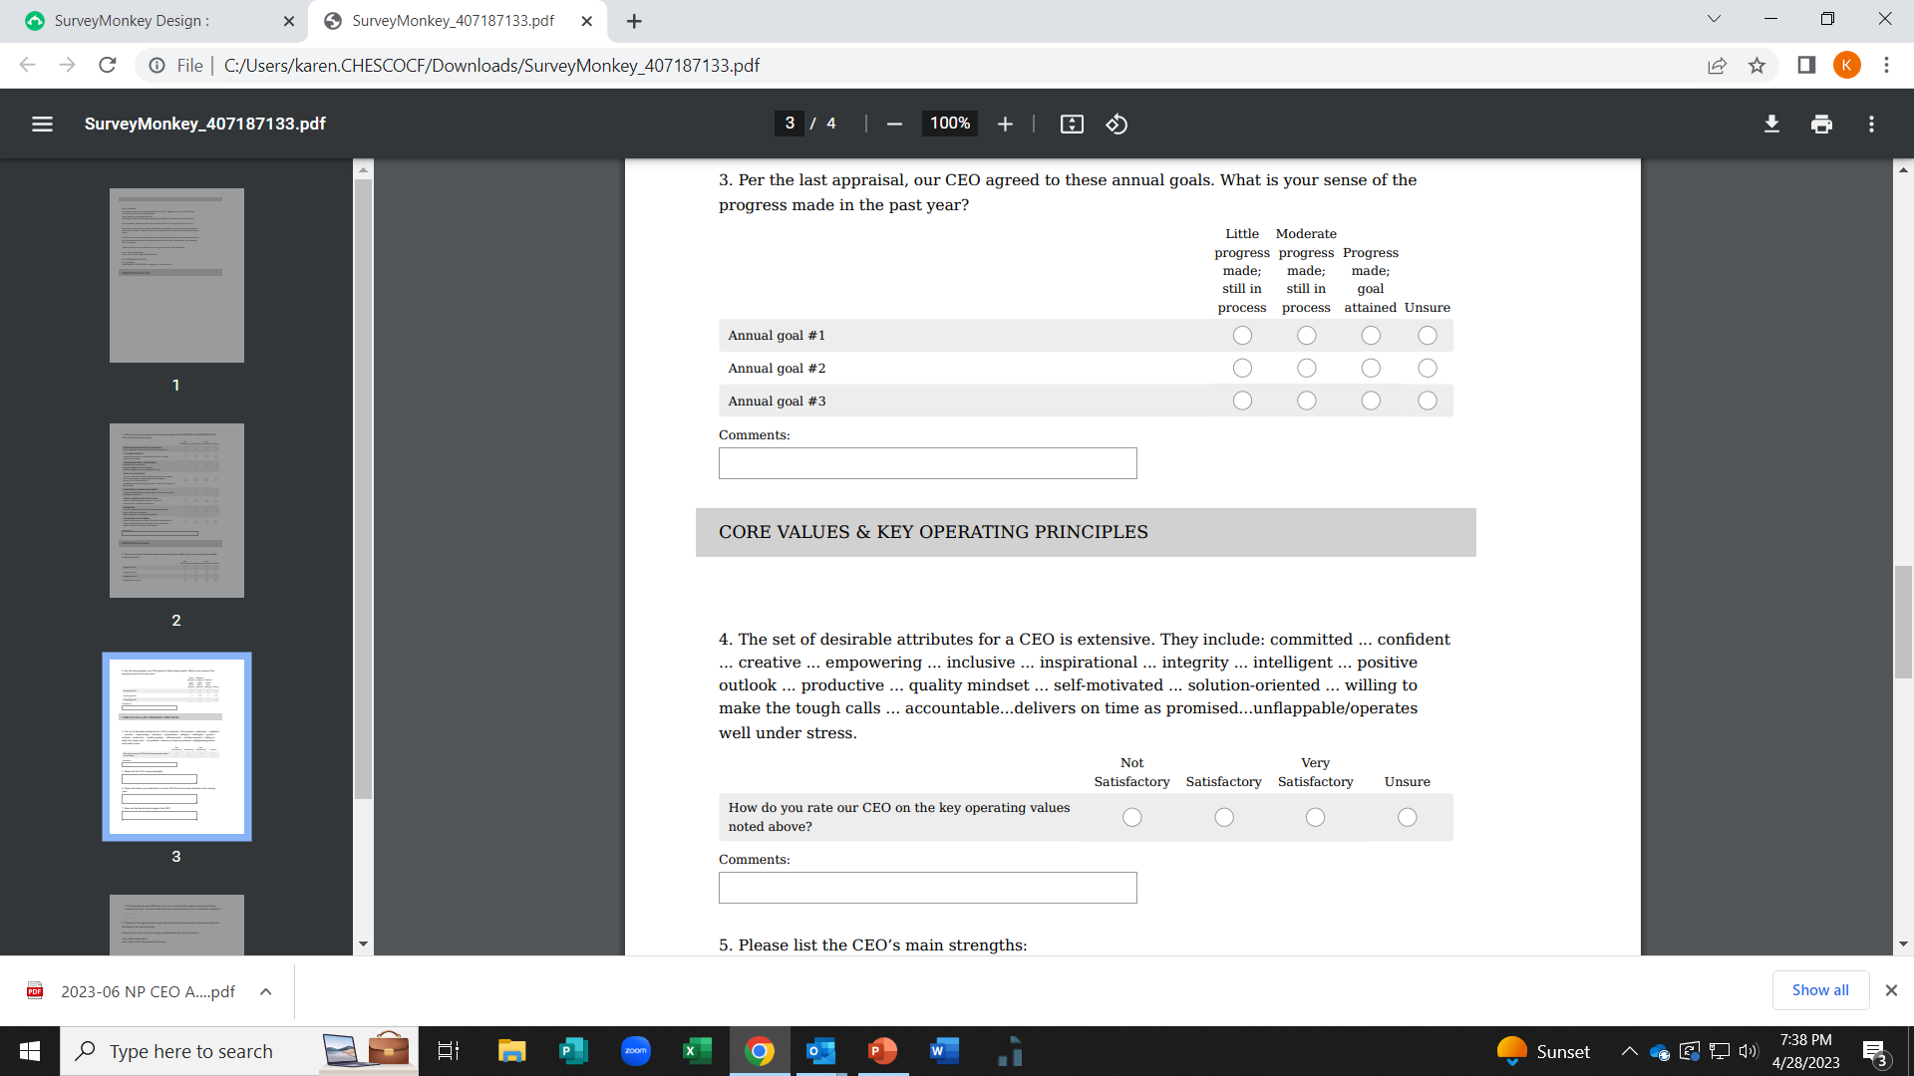
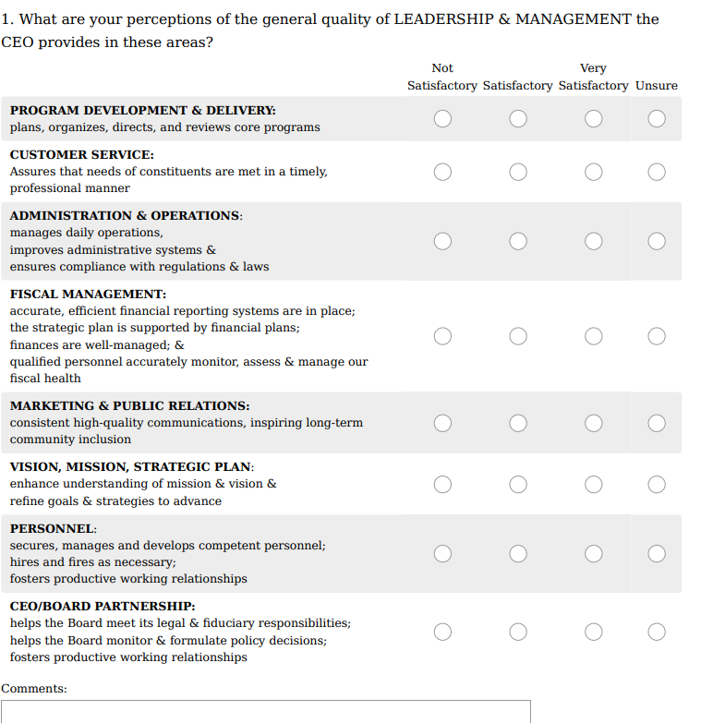
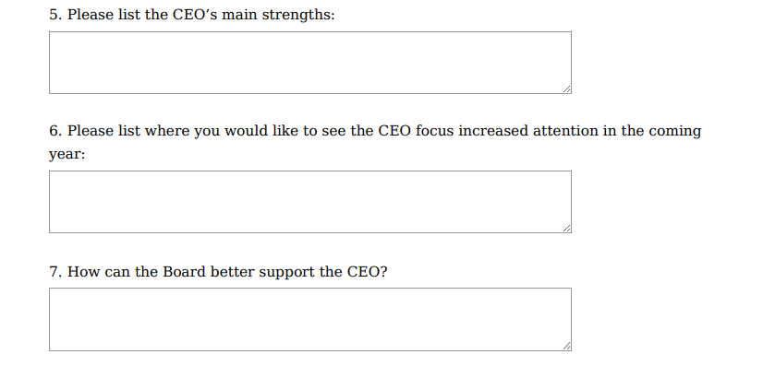
Example-CEO ASSESSMENT: Community Foundation: Online, Can Be Customized, Free
https://chescocf.org/getonboard-resources/
If interested in this
Free
Customized
Online
CEO Assessment Survey
Visit
https://chescocf.org/ getonboard-resources/

Slide 9

How Does Strategic Planning Relate to CEO & Board Assessment?
A strategic plan is a roadmap that helps an organization agree on its focus & aims; a multi-year guide
Envision future initiatives + overall steps to achievement:
goals, objectives, strategies, action steps
outcomes
metrics to measure progress
timelines
budgets
A successful strategic planning process
examines internal and external realities
focuses priorities
helps anticipate and proactively respond/adapt to change
long term (2-10 years)
relatively general in scope
focuses on broad, long-lasting issues needing extra attention

Slide 10

Why Conduct a Board Self-Assessment?
How can a Board-Self assessment help you and your nonprofit organization? Why is it important and useful?
What are barriers to the Board engaging in a self-assessment, at least every other year?
How can we make this a positive, engaging & healthy process?

Slide 11

Board Self-Assessment: Nominating/Governance Committee Responsibility
Individual Board Member Self-Assessment Areas Can Include:
Level of engagement
Being a good steward of the nonprofit’s finances
Effectively communicating the nonprofit’s mission
Making a commitment to training, education, mentorship
Making personal contributions
Being involved in fundraising
Overall Board Performance Self-Assessment Can Include:
Effectiveness, morale and participation in full board, committees and workgroups
Board meeting frequency, length, and impact
Development of a diverse, inclusive board
Strategic planning
Oversight of financial matters
Oversight and participation in fundraising
Forward-thinking and future-oriented

Slide 12
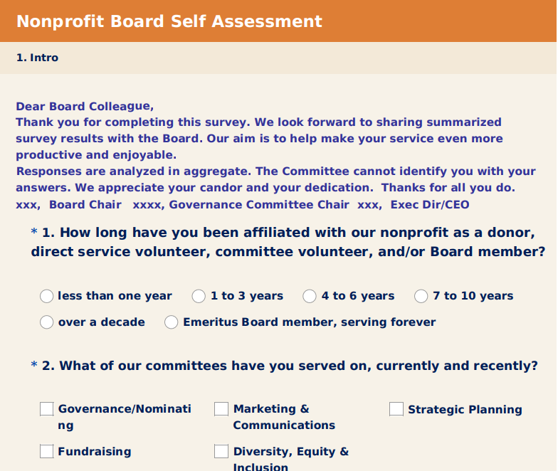
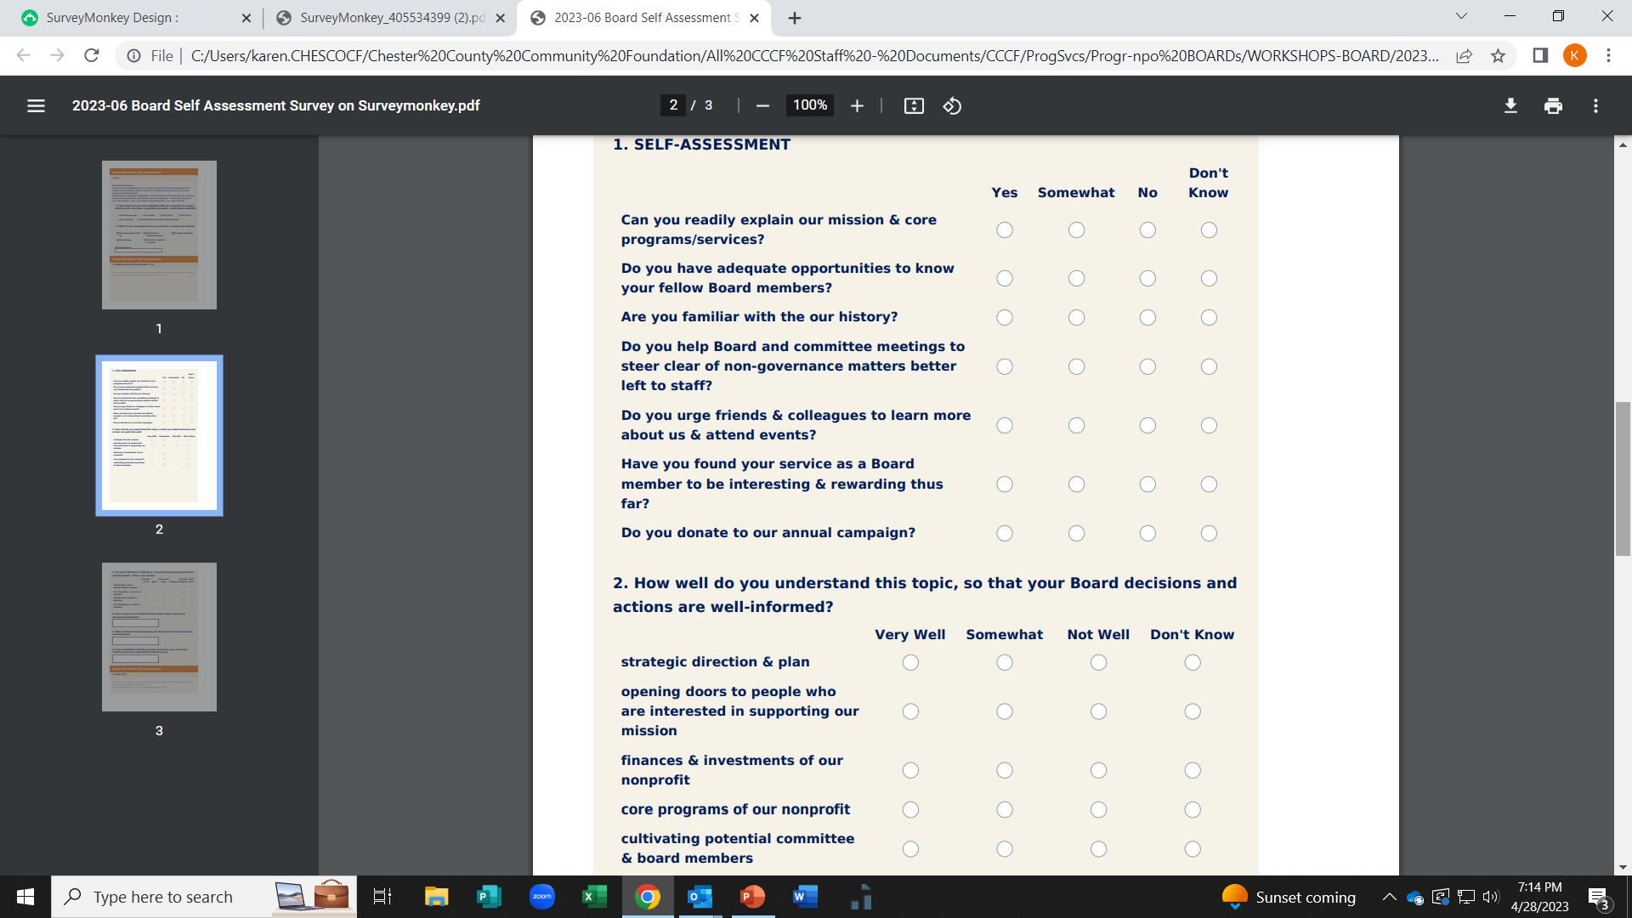
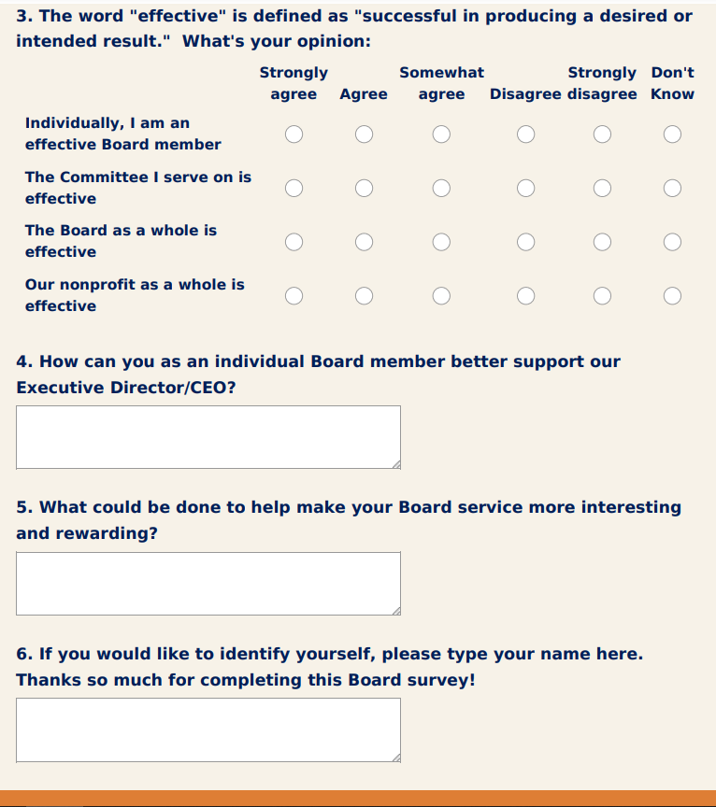
Board Self-Assessment: Community Foundation: Online, Can Be Customized, Free
https://chescocf.org/getonboard-resources/
If interested in this
Free
Customized
Online
Board Self-Assessment Survey
visit
https://chescocf.org/ getonboard-resources/

Slide 13

Feedback Conversations & Summaries
Assessment areas should be based on the job description (for CEO & for Board members) & strategic plan
An assessment needs to be completed by enough respondents so results are meaningful
Reality: It’s uncommon to get 100% input from all board, on both the CEO assessment & Board self-assessment. 80% survey response is acceptable.
Assessment feedback should summarize the responses to the questions + highlight key areas of strength + highlight key areas for development /refinement/refocus
Well-orchestrated assessments foster incremental organizational growth and development, year after year

Slide 14





Resources
Source | URL
Board Source | https://boardsource.org/board-support/assessing-performance/chief-executive-assessments-ace/
Board Source | https://boardsource.org/fundamental-topics-of-nonprofit-board-service/executive-evaluation-compensation/
Nonprofit Risk Management Center | https://nonprofitrisk.org/resources/articles/key-questions-evaluating-ceo-performance/
Board Effect | https://www.boardeffect.com/blog/assessing-board-performance-best-practices-for-nonprofits/
Chester County Community Foundation | https://chescocf.org/getonboard-resources/ CEO Assessment & Board Self-Assessment articles & survey tools

